Slide 1
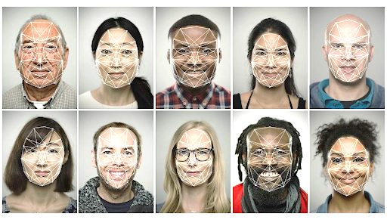
Intelligent Real-Time Facial Recognition System
Supervised by : Pr. Anissa MOKRAOUI
Presented by: Iheb BOUARICHE
Arselan MEGHELLI
Instrumentation and embedded systems
2023/2024
Notes:
Arselan
Good morning everyone. Today, we are here to present our project, the “Intelligent Real-Time Facial Recognition System.” This project leverages AI and embedded systems to solve, digitalize, and automate a real-world problem: attendance tracking, or in other words, student presence tracking.

Slide 2
Contents:
Project presentation
Project Strategy
Software Functionality
Hardware Functionality
Difficulties
Protocol
Results
Conclusion
1/11
Notes:
Arselan
Before we dive into our presentation, let's start with the table of contents.
First, we will introduce our project and explain our solution.
Next, we will cover the project strategy.
Then, we will discuss the software and hardware functionalities.
After that, we will present some results and the difficulties we encountered.
Finally, we will conclude by highlighting the most important benefits of our solution.

Slide 3
Project presentation
An embedded system captures images of students in a classroom.
An AI model processes these images.
The AI model extracts faces from the images.
The AI model recognizes each face.
The system provides a list of the students present and then sends it via the internet.
2/11
Notes:
Iheb
I will begin by talking about our project.
Our project is an embedded system that captures images in a classroom every 10 minutes.
An AI model processes these images to extract and recognize faces.
The system then generates a list of present students and sends it via the internet.

Slide 4
Project Strategy
Phase 1: System Design and Requirement Analysis.
Phase 2: Hardware and Software Development.
Phase 3: Solution implementation and evaluation.
3/11
Notes:
Iheb
Our strategy was divided into three phases:
The first phase was system design and requirement analysis, during which we researched various detection and recognition methods and selected the best models.
In the second phase, we developed a solution and implemented these models in our system.
The third phase involved testing and evaluating different solutions to select the best one.

Slide 5
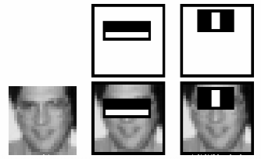
SOFTWARE FUNCTIONALITY
Face Detection:
For this part, we used a trained model from OpenCV. This model was developed using the following techniques/algorithms:
HAAR features.
Image integral.
AdaBoost algorithm.
Cascade classification.
4/11
Figure 01: HAAR features.
Notes:
Iheb
After extensive testing, we found the best solution for our project.
Our solution is divided into two parts: software and hardware development.
For software development, we have two main components:
Face Detection: for the face detection we have an algorithm that extracts faces from an image using four steps:
HAAR Features: Extracted using HAAR filters,
And then with image integral calculations speeding up the extraction process.
AdaBoost Algorithm: A trained model containing small machine learning models that select the most important features for face detection, minimizing features and accelerating detection.
Cascade Classification Model: A machine learning model that detects faces in an image by eliminating non-face regions in stages.

Slide 6
SOFTWARE FUNCTIONALITY
Face Recognition:
VGG-Face deep neural network model.
Trained on VGG-Face dataset (2,6 millions of images).
Extraction of an embedding vector for each face.
Euclidian distance with vectors in dataset.
If the distance is lower than a threshold, then we recognize the face.
5/11
Notes:
Iheb
Face Recognition:
We used a deep neural network with a VGG16 architecture. This model trained on the VGG-Face dataset and it contained 2,6 millions of images.
This model generates a unique vector, called an embedding, which characterizes each face.
Our system compares the predicted embedding with the stored vectors in our dataset to recognize each face, using an Euclidian distance threshold for comparison.

Slide 7
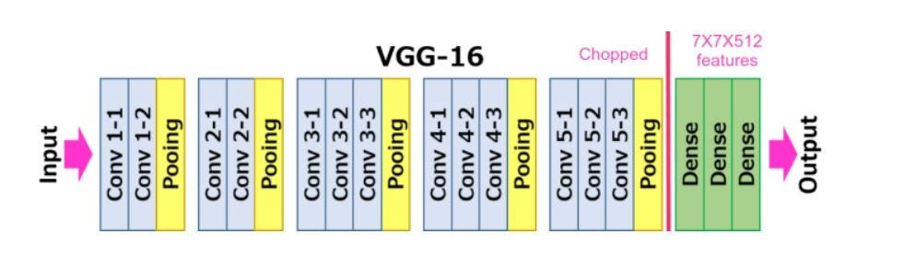
SOFTWARE FUNCTIONALITY
Face Recognition:
VGG-Face deep neural network model architecture:
Figure 02: VGG-Face (VGG-16)architecture.
6/11
Notes:
Iheb
Here, you can see the architecture of VGG-FACE, based on VGG-16.
The input is a cropped image of a detected face, and the output is an embedding vector representing the face’s characteristics.

Slide 8
HARDWARE FUNCTIONALITY
Capture an image every 10 minutes.
Implementation of the Ai models for detection and recognition for each image.
Generate a presence list.
Save this list in an Excel file with necessary information.
Store the Excel file, images of unknown faces, and images of the entire class (captured by the camera initially) in a folder, then transmit them over the Internet.
7/11
Notes:
Arselan
Now, let's discuss the hardware development part.
Our embedded system is programmed to capture an image every 10 minutes, perform facial detection and recognition, and generate the student presence list.
This list is saved in an Excel file, with images of unknown faces and sent via the internet.
I want to note that all these parameters are changeable.

Slide 9
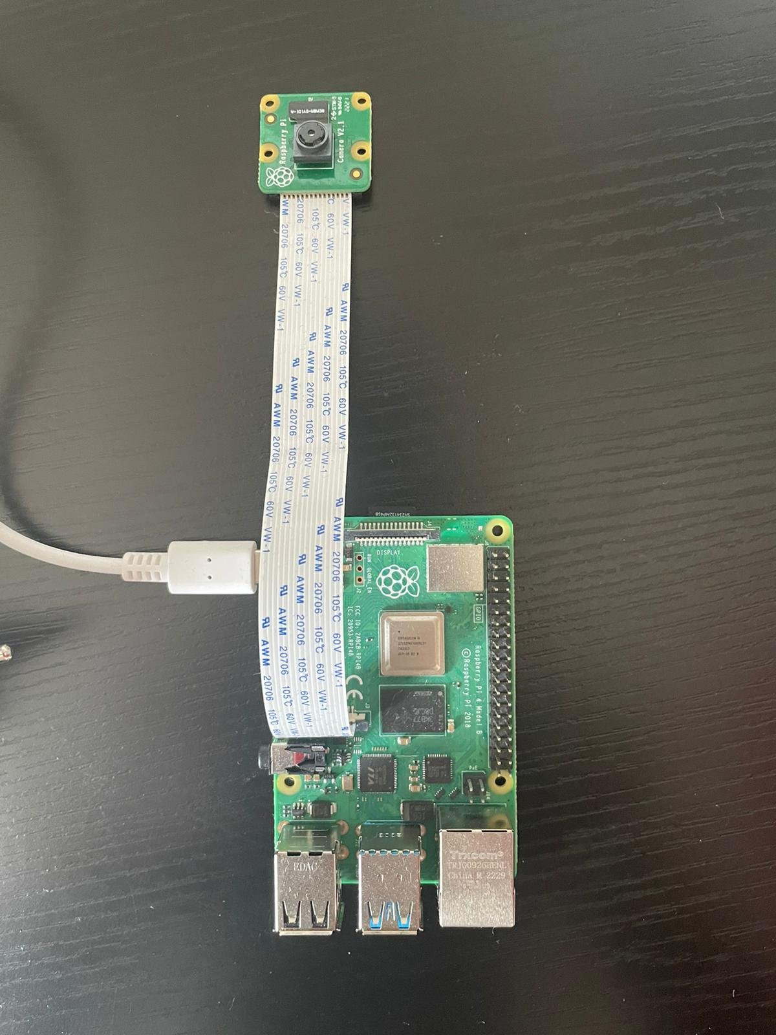
HARDWARE FUNCTIONALITY
camera module
Figure 03: embedded system.
Raspberry Pi card
8/11
Notes:
Arselan
In this image, you can see our embedded system.
At the top, we have a camera module for capturing images.
For processing, we used a Raspberry Pi card.
And the operating system is Linux for Raspberry Pi,
And we used Python environment for developpement.

Slide 10
Protocol
A signal will be displayed on the screen 10 seconds before capturing an image.
Each student needs to face the camera to take a photo of their face.
9/11
Notes:
Arselan
Next, We designed a protocol to ensure the correct capture of images. For this, we programmed a signal that will display a countdown of 10 seconds before taking a picture. Each person must face the camera to have their picture taken.

Slide 11
Difficulties
Challenges in data collection led us to create a virtual database.
We didn’t have access to the equipment, and we haven't received the equipment for our project.
9/11
Notes:
Arselan
We encountered several challenges while developing this solution.
Firstly, collecting images was difficult because our classmates were reluctant to participate.
We had to ask our friends and create a virtual database to overcome this issue.
Additionally, we did not receive the equipment for our project, so we used a Raspberry Pi card from practical sessions and purchased the remaining materials like the camera and SD card ourselves.

Slide 12
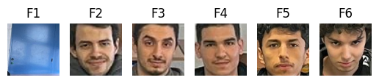
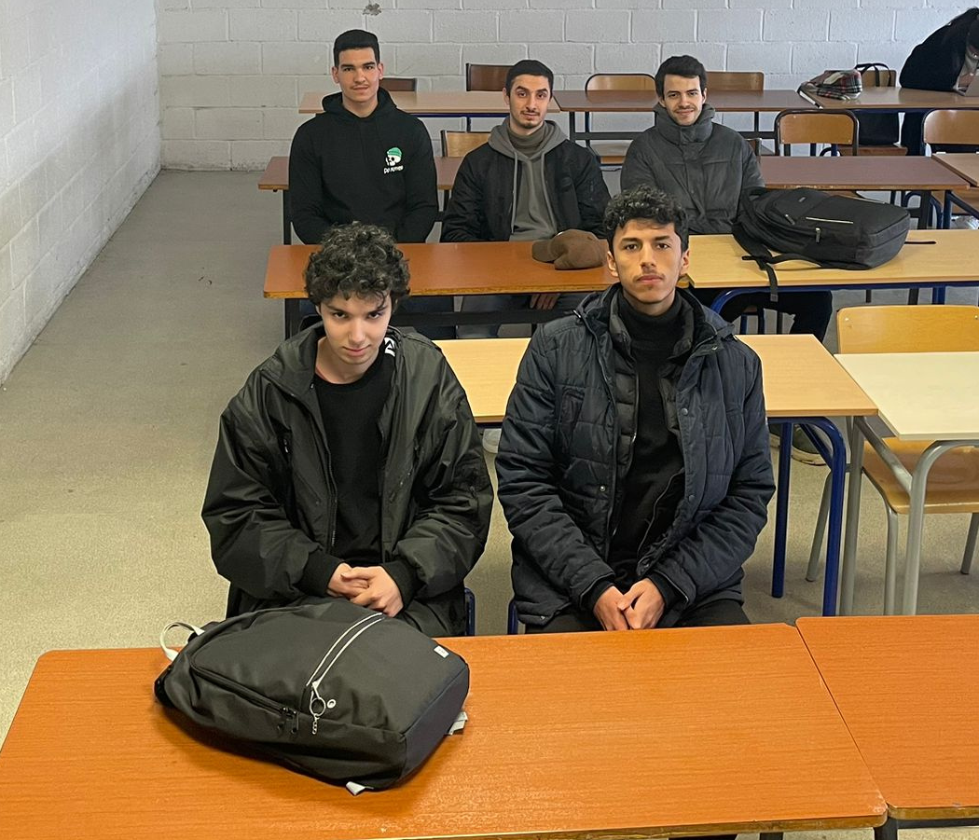
Results
Name | 2024-05-13 18:14:46
AMINE | Present
ANES | Present
ARSELAN | Absent
IBRAHIM | Present
IHEB | Present
REIMI | Present
Face detection
Face recognition
Figure 04: Detection and recognition process.
10/11
Notes:
Iheb
Despite these challenges, we successfully developed our solution.
Here are an example of our face detection and recognition system.
The input is an image, from which we extract and crop faces, and finally, we recognize each face to generate a list of present students with the date and time.

Slide 13
Conclusion
Our system digitizes and automates attendance tracking.
It ensures accuracy and reliability by recording each student's presence every 10 minutes.
Security is enhanced as the system can detect individuals not belonging to the class.
In case of incidents, captured images can serve as evidence for investigations.
11/11
Notes:
Iheb
In conclusion,
our system digitizes and automates attendance tracking.
It ensures accuracy and reliability by recording each student’s presence,
enhances security by detecting individuals that not belonging to the class,
and can serve as evidence for investigators in case of incidents.

Slide 14
Thanks
Notes:
Iheb

